Slide 1
Part 3 Uses of HDF
Uses all slides

Slide 2
Who uses HDF5?

Slide 3
Who uses HDF5?
Applications that deal with large or complex data
Over 200 different application areas
Estimate 2 million data product users world-wide
Academia, government agencies, industry
Notes:
Types of apps growing – over 200 different types of applications of HDF5 reported
Uses HDF are quite varied, and include sensor data management and acquisition, archiving, image repositories and interchange, scalable computational meshes storage and retrieval on massively parallel systems, remote-sensed data access and distribution, as a container for heterogeneous collections of complex data, or as an object store for object relational databases.
R&D 100 award – in 2002, “one of the 100 most technologically significant products of the year”
Serious adoption and reliance on HDF5
Scientific and engineering disciplines such as physics, cosmology, medicine and meteorology rely on HDF technologies
Government and quasi-government agencies using for day-to-day operations, long term preservation
Next generation US civil and military weather system will use HDF5 for data distribution
Aberdeen Test Center using HDF5 as object for DB of 800,000 tests
Also in Europe – EU project to use HDF5 for product model data
Companies like Boeing, Agilent, GE adopting for company-wide data management
Some industries you wouldn’t expect – finance; film-making (Lord of the Rings)
Increasing need for support, services, quick response
In 2004 a company wanted to hire about half of our staff to build infrastructure for company-wide use of h5.
Aberdeen Test Center needed quick porting of HDF5 Java library to 64-bit Linux
Etc.

Slide 4
Sample uses of HDF 2006

Slide 5
When someone downloads HDF5 from the HDF Group website, we ask them to identify the “project field.”
In 2006 we took the list of project fields, which included about 600 entries, eliminated obvious duplicates and irrelevant entries, and came up with the following list of approximately 250 entries.
There is still probably quite a bit of overlap, and some entries aren’t really project fields, but the message seems clear that there are a lot of different uses of HDF5.

Slide 6
“Uses of HDF” from webpage
Academy of Sciences, Russia
Accelerators & FEL Physics
Acoustics
Advanced Fuel Cycle
Advanced Parallel Numerical Simulation
Aeronautic testing
Aeronautics
Aerosol Analysis from MISR data
Aerospace
Agent Based Modeling
Agricultural research
Air Traffic Control
Airbourne Laser Project (ABL)
Aircraft Emissions Database
Airborne Remote Sensing
Air-Sea Interaction
Animal Functional Genomics
APAC National Facility Scientific Staff
Applied Mathematics
Archeology
Astronomy
Astrophysics
astrophysics / supernovae

Slide 7
Astrophysics/Computation Science
Atmosphere
Atmospheric Chemistry
Atmospheric Physics & Dynamical Meteorology
Atmospheric radiation
automotive
band gap
Bathymetric database
Bioeffects of Electromagnetic Fields
Bioengineering
Bioinformatics
biological
Biomedical Applications
biomolecular modeling
biophysics
biostatistics
biotech
Brain Research
bridge C++/java
build and install packages for researchers
cdf
CEM Simulation
CERSAT

Slide 8
CFD
Chemical Reaction Engineering
chemistry
Climate Change
Climate Modeling
Climate Physics
Climatology, Hydrology
cloud physical
Comp Accelerator Physics
computational biology
computational chemistry
Comp Electromagnetics
Computational Grid
Computational Mathematics
Computational Physics &
Computational Astrophysics
Computational Science/HPC
Computer Aided Engineering (Durability/Safety)
computer modeling
Computers for Nuclear fuel design
Computer simulation
Condensed Matter Theory and materials science
construction of a Beowulf class computer
Cosmic ray modulation in the heliosphere
cosmology
Cplant IO

Slide 9
data assimilation in meteorology
Data structures, programming abstraction, and run time support for parallel computation of adaptive and irregular problems
Data Viewer
Dawning Cluster File System
derivation of cloud characteristics
development of magnetic mass spectrometers
Diffusion Tensor Magnetic Resonance Imaging
dislocation dynamics - material modeling
Displaying WSI's Nexrad Image
DOD Testing and Evaluation
Earth and Space Science visualization
Earth Observation / Remote Sensing
Earth Observation/Atmospheric Science
Earth Resources
Earth Science, Applied Info Sys
ecology
EDC/ECS Operations Operator
education
Electrical and Computer Engineering
electromagnetics

Slide 10
Electronics
Environmental modeling
Environmental modeling and soil science
Environmental monitoring
Environmental Research
environmental/meteorological
Failure Analysis
Fast searching, sorting and retrieval
FEL Physics
final year dissertation
financial research
Flight test data analysis
Fluid Mechanics
Fluid Dynamics
Fracture Mechanics
Fundamental Physics in Space
Fusion Plasma Physics
Fusion Science
Geodetic Science
Geographic map updating
Geology
geology, environment science
Geophysics
Geostationary Earth Radiation Budget Sensor
GERB instrument on MSG satellite
GIS

Slide 11
GIS & Remote Sensing
Globus Project
GrADS, MicroGrid
Gravitational physics
Groundwater heat and solut transport with reactions
Guinean Research Institute Support
HIRDLS/AURA
HPUX Porting and Archive Centre
Hurricane Research
Hydrodynamics
hydraulics
Hydrology
ILUMASS - Integrated Land-Use Modeling and Transportation System Simulation
Image Processing
Information Technology
integrated optics
Interpretation of Aeroelectromagnetic Data
Land surface modeling (water, carbon)
Land use and land cover maps in Senegal
LANL ASCI program

Slide 12
Laser Plasma experiments
magnetohydrodynamics
Marine Biology - Ecology
marine fishery
MAT
material physical
materials simulation
Mechanical Engineering; To be used by MIT Photonic Bands package to output the field information
medical physics
Meteorology
Metrology
Microscopy
Modeling
Molecular Biology: Tech Development
Molecular Level Physiology
N3C - GAB
Nano device simulation
NASA EOS Land Data
NASA SORCE Mission
Naval Arch & Marine Engineering
Neural analog/digital VLSI IC
Neuroscience research
Neutron Scattering
nonlinear optics

Slide 13
JPSS Software Development
Nuclear Engineering
Numerical fluid dynamics
numerical general relativity
numerical relativity
NYSCEDII
ocean color
Ocean Dynamics
Ocean Physics
Ocean Remote Sensing
Oceanography
Oceanography - surface currents - radar
Oil & Gas Visualization
Oil Exploration
optical information technology
Optical Integrated Circuit Design
Optics
Optoelectronics
Ozone Monitoring Instrument
Parallel Programming
PDE
Performance Modeling and Evaluation
Petroleum Engineering
petrology
photonic band gap studies
Photonic Crystals, INFM PRA
Photonics
Physical Oceanography

Slide 14
physics
Physics (Medical Physics)
physics / numerical simulation
Physics, Optics
Physics, Photonic band gaps
Physics/Materials Science
Physics, Optics, Metrology
Plasma / Electromagnetics
Plasma Physics
Plasma Physics - Nuclear Fusion
Polymer physics
Post-fire erosion analysis
Processing of (weather) radar images
Process-understanding arsenic groundwater contamination in West Bengal/Bangladesh
protein crystallography, molecular modeling
Protostellar accretion discs
Quantitative Precipitation Forecast
Quantum Chemistry
Radar
Radar and Satellite data processing
Radar Science
remote science
Remote Sensing

Slide 15
Remote sensing, satellite meteorology
Research
Robotics
SAF
SAMRAI
SAR processing
SATC
satellite
Satellite Climate Monitoring
satellite Image
satellite image viewer
Satellite meteorology
Satellite oceanography
satellite remote sensing
Satellite/weather radar remote sensing
Scanning Near Field Optical Microscopy
SciDAC
science
scientific graph and data analysis
Sea Ice
seafloor modeling
Seismology
Semiconductor Process Simulation
Ship hydrodynamics
Signal Processing
signal processing
SNOW melting
Software Engineering, Distributed Systems
Solid State Physics
Southern Ocean predator ecology

Slide 16
Space Geodesy
Space Modeling
Space Physics
Space Plasma Physics
Space Sciences
Statistics
Student just looking for a way to view hdf files
supercomputing
Support to geophysical applications
Surface water flow and sediment transport
SWX: Space Weather Explorer
System support/integration/flight test
Systems Analysis
telecommunications
theoretical chemistry
To retrieve SST from MODIS data in Indian Ocean
trabajo académicamente dirigido
TRMM
Underwater acoustics

Slide 17
vision research, neuroscience
Visualization
Visualization and Analysis Software
Volcano Simulation project
Volcanology
Water Modeling
Water Resources Management
Weather Data Display
X-ray physics

Slide 18
Organizations who currently fund HDF
NASA - EOS/Raytheon, JPSS/SGT, Langley
NASA/SGT – JPSS
DOE National Labs - LBNL, ANL, LLNL
NCSA
Sandia National Lab
Synchrotron community
Aerospace
Financial

Slide 19
Examples of HDF5 Applications

Slide 20
Earth observing System

Slide 21

EOS Constellation of Satellites
Terra
CERES MISR MODIS MOPITT
Aqua CERES MODIS AMSR
Aura
Aqua (6/01)

Slide 22
NASA EOS
Requirements
Open standard to exchange remote-sensed data
Earth science data types (HDF-EOS swath, grid, point)
Efficient storage and access
Terabytes of data every day – now 3 petabytes
Large, diverse community of users – now 1.6 million
TRL 9 Actual system "mission proven" through successful mission operations (ground or space)
Notes:
Start here.

Slide 23
EOSDIS HDF Project
What we do
Maintain/develop formats (HDF4 & HDF5) & I/O libraries
Provide support, documentation, tutorials, workshops
Tools for viewing, editing and managing HDF

Slide 24


Slide 25
What is JPSS?
JPSS is the next generation of low earth orbiting environmental satellites.
The JPSS will circle the Earth approximately once every 100 minutes.
The JPSS will provide global coverage, monitoring environmental conditions, collecting, disseminating and processing data about the Earth's weather, atmosphere, oceans, land, and near-space environment.
The JPSS will collect a massive amount of earth surface, atmospheric and space environmental measurements from a variety of on-board sensors.

Slide 26
Flight Testing

Slide 27
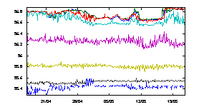
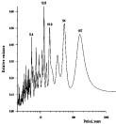
Collect data one way, view it another
HDF “Packet”
HDF “Time-history”

Slide 28
Boeing flight test data
4TB of data each test flight
Real time data acquisition
Different views of data
Archive
Support for VMS
Notes:
Start here.

Slide 29

Flight Test Data Flow
Archive
(TDRS)
FTCS
Flight Test
Computing System
(Data Stored)
Flight Test Data
Data Request

Slide 30
The Three HDF File Types
HDF Time Segment:
Raw Data Storage
FDS-HDF:
Data Request
Submission and Storage
Archive Index:
File Management

Slide 31
The Search for a Common Data Format
Today on the Boeing History Channel…
Rod Davis

Slide 32
Historically Speaking…
August 1997 – MDC merges with Boeing
February 2002 – Started Tech Meetings
December 2002 – HDF-TimeHistory Spec
October 2003 – OA with NCSA
February 2004 – NCSA-Boeing Meeting

Slide 33
What were those features again?
Remove Limitations
Current file sizes ceiling of 2G
Selective platforms & languages
Fixed (typically) data types
Features
High resolution time (nanosecond)
Asynchronous parameter
Dynamically read, write, append and delete
Flexible application programming interface (API)
Compression & chunking
XML exchange of data
Data Sharing
Non-proprietary format
Open source
Distributed libraries

Slide 34

One Use… Multiple Data Sources
Satellite
Missile
Shooter Aircraft
Non-Time Based
Data
Target Aircraft
Communications
Aircraft
Video
Ground
Tracking
Voice Communications
Documents
Testing can have several sources of data for a single event.
Manage those sources and information in a single file.

Slide 35
Then and Now
Previous data files typically were restricted to contain data from a single source without “shoehorning” in data from another source.
The data file was the limiting governor for subsequent applications and tools.
With HDF-Time History, there are virtually no restrictions associated with the data file… only the functionality of the applications are the limits.

Slide 36
Hierarchy Basics
“/” (root)
Event
Source
A file can contain one or more events.
Each event can contain one or more sources.

Slide 37
The HDF-Time History File Adapts to the Data not the other way around!
Store Data As Gathered
No alterations to data
Visibility to all data processing steps
Sources and Parameters can be Asynchronous
Parameters can be the Same Name for Different Sources
Data Points may be Marked for Exclusion
Very Adaptive
Any Type of Data can be Stored
Most Data is Self-Describing
General Categories of Audio, Video, Documents
Start to Finish Data in one container

Slide 38
A Source Can Be Many Things Example 1… more to follow

Slide 39
Product Model Data

Slide 40
STEP - Product data exchange
NASA, ESA, EU
HDF pilot project funded by NARA
Requirements
Binary file format to replace current text-based format STEP (ISO standard)
Support complex data objects and hierarchies of data models
Open source and future ISO standard
Notes:
Start here.

Slide 41
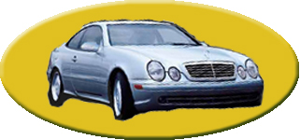
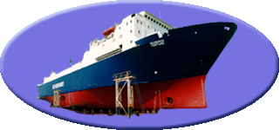
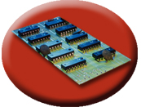
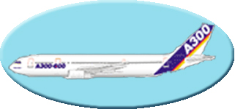
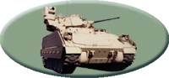
Product data exchange – STEP
STEP is an ISO data transfer standard.
Defines characteristics of product throughout its life cycle.
Widely used in design and manufacturing.
Uses EXPRESS data modeling language to describe data.
STEP

Slide 42
Computational Fluid Dynamics Community Standard

Slide 43
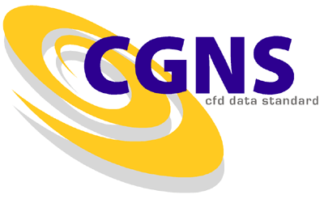
CFD General Notation System
Notes:
CFD: Computational fluid dynamics

Slide 44
What is CFD?
Computational fluid dynamics (CFD) is a branch of fluid mechanics that uses numerical methods and algorithms to solve and analyze problems that involve fluid flows.

Slide 45
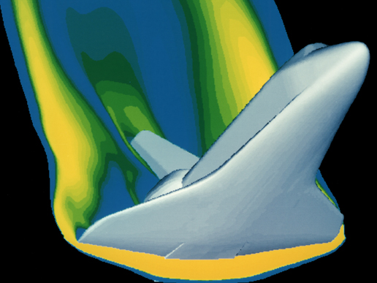
This CFD computer generated image shows a model of the space shuttle. CFD has taken the place of wind tunnels for many evaluations of aircraft and, as computing power increases and computer models become more sophisticated, CFD will largely replace wind tunnels.

Slide 46
What is CGNS ?
Standard Interface Data Structures (SIDS)
Collection of conventions and definitions that defines the intellectual content of CFD-related data.
SIDS to HDF5 Mapping
Defines how the SIDS is represented in HDF5
CGNS Mid-Level Library (MLL)
Application Programming Interface (API) which conforms to the SIDS
Built on top of HDF5, which does I/O operations

Slide 47
CGNS and HDF5*
CGNS was originally built using the ADF format.
However, ADF does not have parallel I/O or data compression capabilities, and does not have the support and tools that HDF5 offers.
HDF5 has rapidly grown to become a world-wide format standard for scientific data.
HDF5 has parallel capability as well as a broader support base than ADF.
Therefore, CGNS has adopted HDF5 as the default (official) data storage mechanism.
* Paraphrased from http://cgns.sourceforge.net/hdf5.html.

Slide 48
cosmology

Slide 49

An adaptive mesh refinement (AMR), grid-based hybrid code which is designed to do simulations of cosmological structure formation.

Slide 50
What is ENZO for?
At UC San Diego ENZO cosmology is used to simulate the universe from first principles, starting near the Big Bang.
Researchers using ENZO have conducted the most detailed simulations ever of a region of the universe more than 1.5 billion light years across.
“We need to zoom in on these dense regions to capture the key physical processes -- including gravitation, flows of normal and ‘dark’ matter, and shock heating and radiative cooling of the gas,” said Mike Norman. “This requires ENZO’s ‘adaptive mesh refinement’ capability.”

Slide 51
“AMR codes begin with a coarse grid spacing, and then spawn more detailed subgrids as needed to track key processes in higher density regions.
“We achieved unprecedented detail by reaching seven levels of subgrids throughout the survey volume -- something never done before -- producing more than 400,000 subgrids,” said SDSC computational scientist Robert Harkness.
“Norman is one of the largest users of supercomputing time in the world, with 16 million computing hours at the TACC, and millions more on TeraGrid systems at SDSC, PSC, and NCSA.”
“The HDF Group provided important support for handling the output, and SDSC’s data storage environment allowed the researchers to efficiently store and manage the massive data.”

Slide 52
Bathymetry (Soundings on steroids)

Slide 53
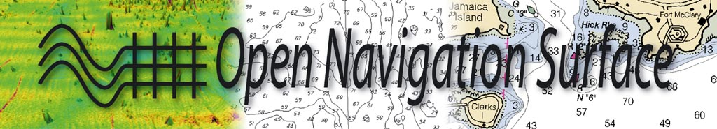

Slide 54
Traditional soundings sheet

Slide 55
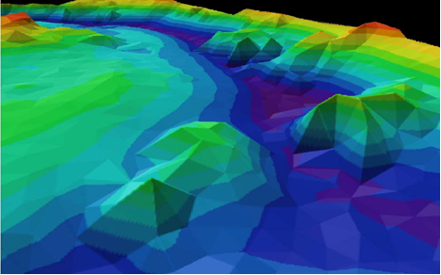
Soundings as triangles rendered

Slide 56
The same seafloor at the full resolution of a multibeam sonar survey.

Slide 57
http://www.opennavsurf.org/presentations/ons_shallowsurvey2005_ppt.pdf

Slide 58
high speed detectors

Slide 59
NeXus

Slide 60
What is NeXus?
In recent years, scientists and programmers in neutron and synchrotron facilities around the world concluded that a common data format would fulfill a valuable function in the scattering community.
As instrumentation becomes more complex and data visualization more challenging, scientists find it difficult to keep up with new developments.
A common data format makes it easier to exchange experimental results and to exchange ideas about how to analyze them. It promotes greater cooperation in software development and stimulates the design of more sophisticated visualization tools.
The NeXus data format has been developed in response to these needs.

Slide 61
NeXus
NeXus instruments:
http://www.nexusformat.org
Neutron science applications
http://www.sns.gov/index.shtml

Slide 62
End of Part 3.1

